Slide 1
Credersi-Vend Admin Project

Slide 2

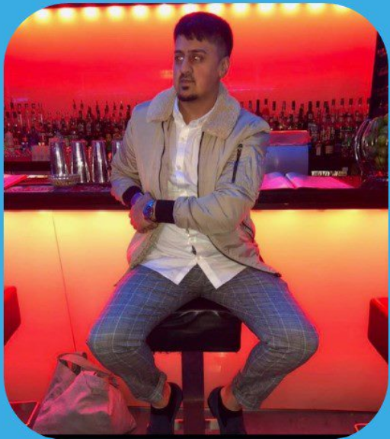
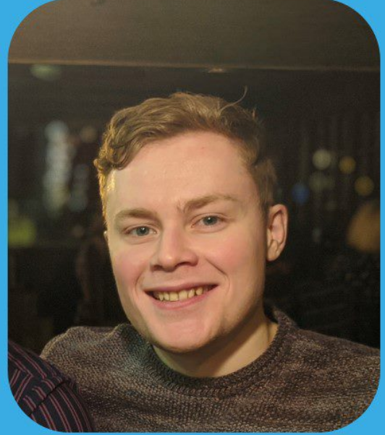
Meet the Ahoy Travel team!
Alec Riding
Avais Hussain
James Croxford
Notes:
Meet our team! I’m Avais, this is James and Alec. We are graduate testers part of the ROQ test engineering academy 2022.

Slide 3
Agenda
Introduction​ Of Product And Requirements
​Approach and Planning
Test Case Design
​Testing the levels
Bug Reports
Blockers
Summary
Notes:
Before we go into the actual presentation we would like to give you an overview of what you can expect to be covered during this. We will start off by giving you an introduction on what the product is that we have been testing and the requirements. Following this we will touch on the approach we took to testing and planning. There will also be an explanation of test case design and how we went about testing the levels. These four levels are: Component testing, integration testing, system testing, and acceptance testing.

Slide 4
Background
Founded in 2009, Bury St Edmunds
Supply and operate vending machines
They sell premium Suffolk products
Notes:
]

Slide 5
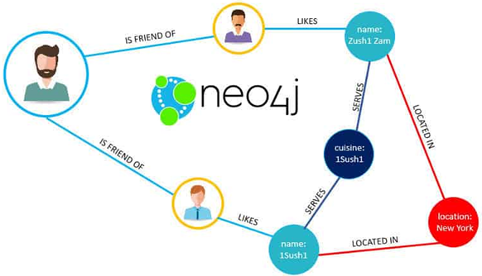
Introduction
Web based Application
Which users can use to manage vending machines.
Hosting a database, using NEO4J.
The main functions of the webpage are:
Login
Create Customer Companies
Create Sites
Create Machines
Notes:
The credersi-vend admin application is a web based application. The purpose of this is to allow engineers easy access to locating different vending machines at different sites and aid in the management of these machines. The web application also consists of a database that is hosted using neo4j. We have identified the application to have 4 main functions. These are: the login function, the create customer function, create sites function, and the create machine function.

Slide 6
Objectives
Minimum viable product
Find defects to prevent failures
Document bugs
Test the application

Slide 7
Approach and planning

Slide 8
WEEkLY PLANNER
Week 1 | MONDAY 5/09/2022 | TUESDAY 6/09/2022 | WEDNESDAY 7/09/2022 | THURSDAY 8/09/2022 | FRIDAY 9/09/2022
8:45:9:00 | Standup With Everyone | Standup With Everyone | Standup With Everyone | Standup With Everyone | Standup With Everyone
10:00 - 10:45 | Set Up Our Workspace | Created Trello Board | Test Strategy | User Stories | Test Cases
11:00 - 11:45 | Set Up Environment & Forked Work | Test Plan | Test Strategy | User Stories | Test Cases
12:00 - 13:15 | ✔ Free Time | ✔ Free time | ✔ Free Time | ✔ Free Time | ✔ Free Time
13:30 - 14:15 | Set Up Environment & Forked Work | Test Plan | Test Strategy | Gant Chart | Test Cases
14:30 - 15:15 | Set Up Environment & Forked Work | Test Plan | Test Strategy | Sprint Planning | Test Cases
15:30 - 16:15 | Created Trello Board | Test Plan | User Stories | Test Cases | Test Cases

Slide 9
WEEkLY PLANNER
Week 2 | MONDAY 12/09/2022 | TUESDAY 13/09/2022 | WEDNESDAY 14/09/2022 | THURSDAY 15/09/2022 | FRIDAY 16/09/2022
8:45:9:00 | Standup With Everyone | Standup With Everyone | Standup With Everyone | Standup With Everyone | Standup With Everyone
10:00 - 10:45 | Testing | Testing | Documentation For Defects | Commit Github | Preparation
11:00 - 11:45 | Testing | Testing | Documentation For Defect | Feedback | Preparation
12:00 - 13:15 | ✔ Free Time | ✔ Free Time | ✔ Free Time | ✔ Free Time | ✔ Free Time
13:30 - 14:15 | Testing | Testing | Presentation | Reflection | Presentation
14:30 - 15:15 | Testing | Testing | Presentation | Reflection | Presentation
15:30 - 16:15 | Testing | Testing | Commit Github | Reflection | Presentation

Slide 10
Approach & planning
Test Plan
We decided to create a test plan before we actually kick off the project so everybody is aware of what is needed to be done.
Test Strategy
We decided to put in place a test strategy that encompesses guidelines and principles involved in testing process

Slide 11
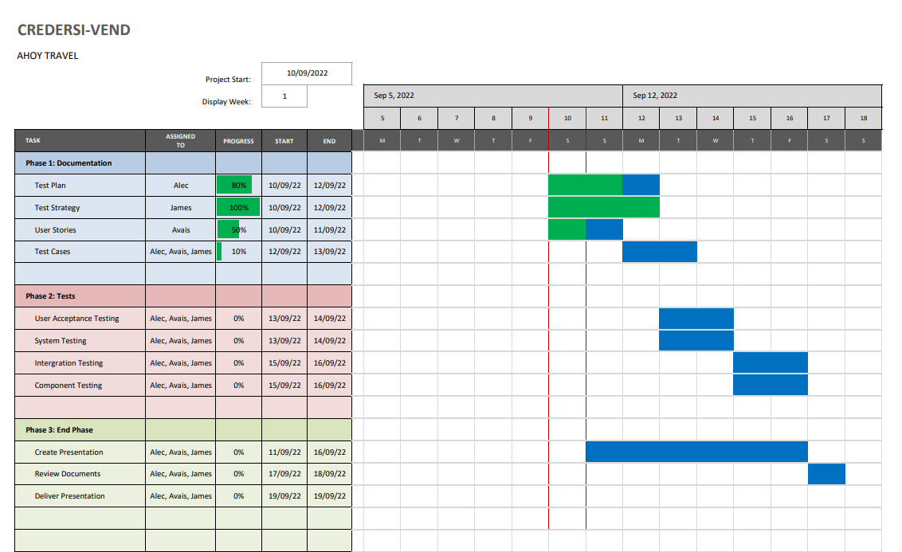
GANTT CHART

Slide 12
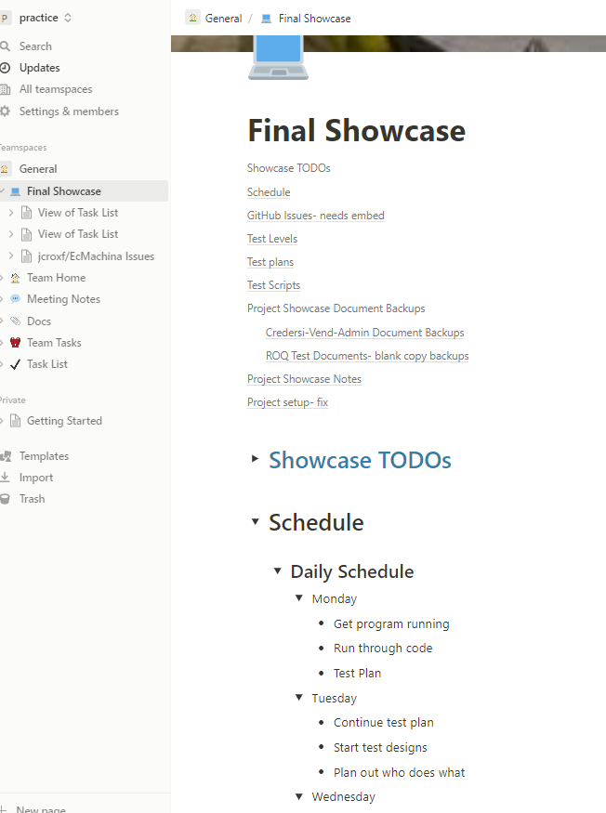
GANTT CHART
Notes:
Used notion better pic required & title

Slide 13
Test Case Design

Slide 14
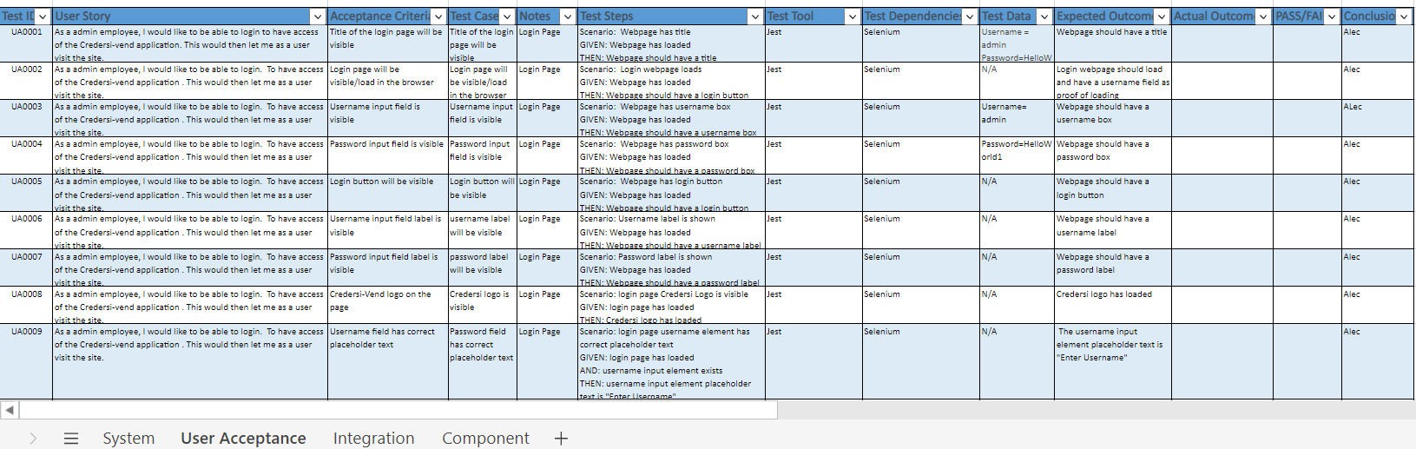
Test Case Design
Notes:
We created an excel spreadsheet that consisted of user stories, test cases, acceptance criteria, outcomes, etc for all 4 different test levels. This was used to help keep track of the user stories that were created and the test cases linked to them. This also helped the process of scripting tests as it meant we could easily understand how to go about automating the test cases. This spreadsheet was updated by all members of our team which meant that it was constantly being changed and new information added to it. We felt that this was a great way to keep track of all the important information and test data as it is displayed in a clear and concise way.

Slide 15
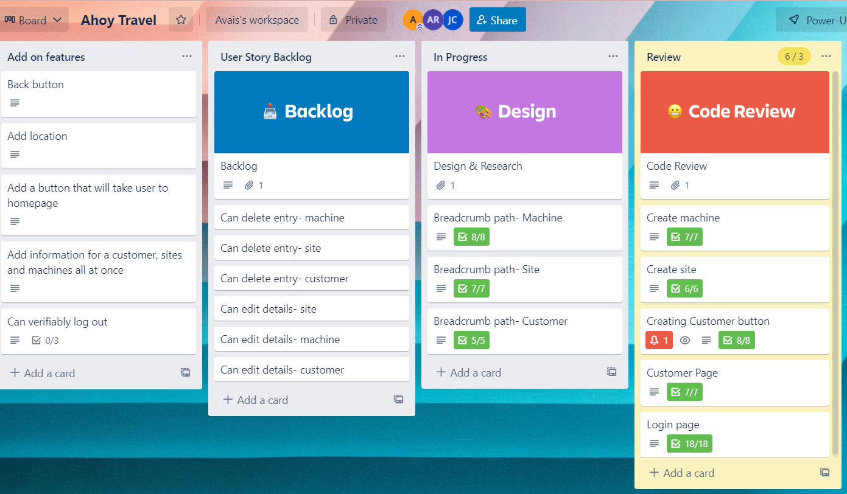
Trello Board

Slide 16
Testing The Levels

Slide 17
Four Levels
Component
Integration
System
Acceptance
Notes:
Before the release of an application, it undergoes a thorough testing process in an attempt to ensure that the application is working in the way it was intended to do so. To enhance the quality of software testing, the process of testing can be abstracted into different levels. These are known as the levels of testing and there are four main ones. So, what are these? The first is component testing, this is followed by integration testing, which leads to system testing and finally, acceptance testing. Each of these levels have a specific purpose. In this project there were three main components (frontend, backend, and routes) all of which had to be integrated to become one system that is accepted by the client.

Slide 18
Test level we did in order
Acceptance
System
Integration
Compontent
Notes:
Alec OR James floz said to make sure you specify why we did it in this order instead of the actual way

Slide 19
Component Testing

Slide 20
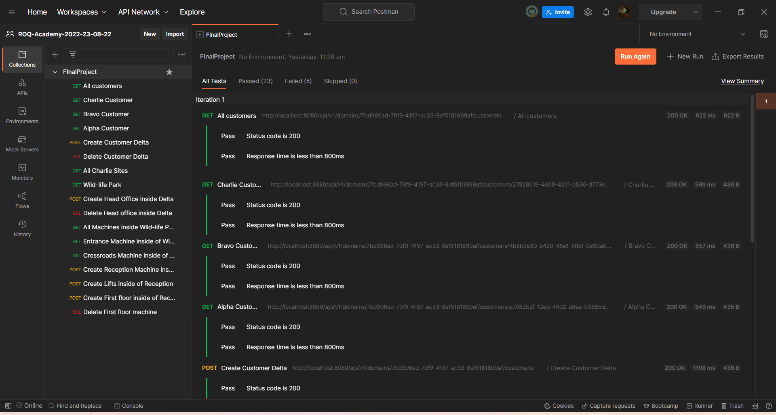
Integration Testing

Slide 21
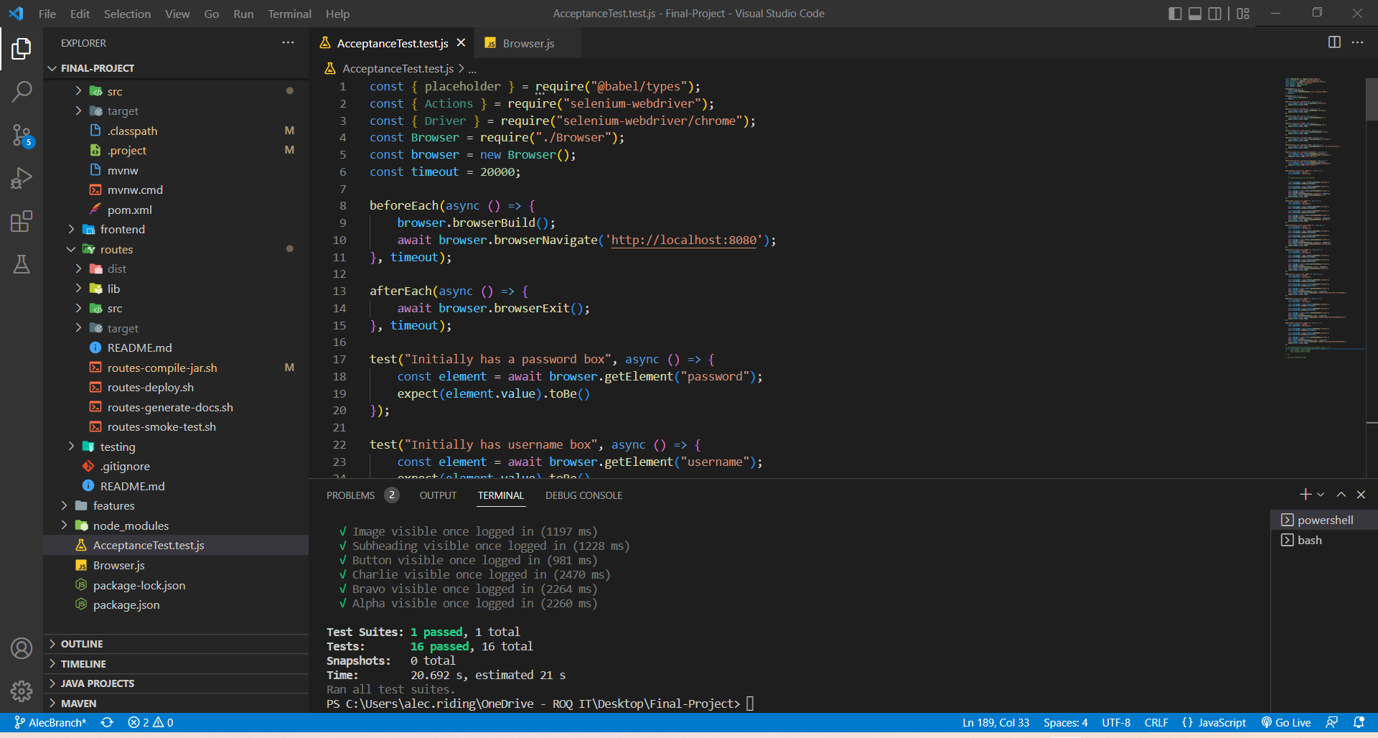
System Testing

Slide 22
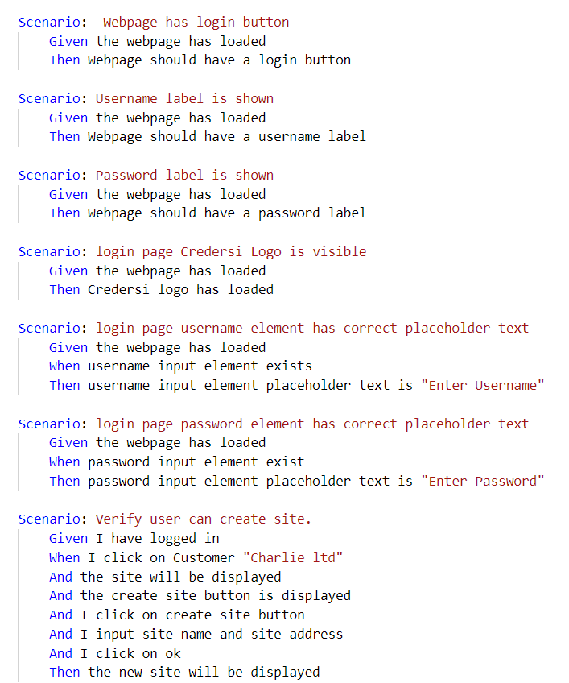
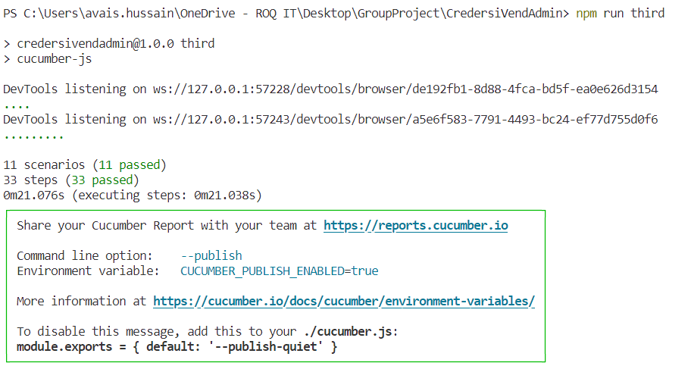
Acceptance Testing

Slide 23
89,526,124
Whoa! That’s a big number, aren’t you proud?

Slide 24
Bug report

Slide 25
Blockers
Set up environment
Setting up framework
Inexperience team
Debugging

Slide 26
Exhausive Testing is impossible !
The absence of errors fallacy !

Slide 27
LET’S REVIEW SOME CONCEPTS
Yellow
Is the color of gold, butter and ripe lemons. In the spectrum of visible light, yellow is found between green and orange.
Blue
Is the colour of the clear sky and the deep sea. It is located between violet and green on the optical spectrum.
Red
Is the color of blood, and because of this it has historically been associated with sacrifice, danger and courage.
Yellow
Is the color of gold, butter and ripe lemons. In the spectrum of visible light, yellow is found between green and orange.
Blue
Is the colour of the clear sky and the deep sea. It is located between violet and green on the optical spectrum.
Red
Is the color of blood, and because of this it has historically been associated with sacrifice, danger and courage.

Slide 28
CREDITS
Special thanks to all the people who helped and supported us during the project:
Laurence Martin (Floz)
Madeline Harrop
Steven Knowles
Amira and Andy

Slide 29

THANKS FOR KINDLY LISTENING!
Any questions?

